Slide 1
JSX Templates, Components and Data
Jon Galloway | Technical Evangelist
Christopher Harrison | Content Developer

Slide 2
JSX Syntax

Slide 3
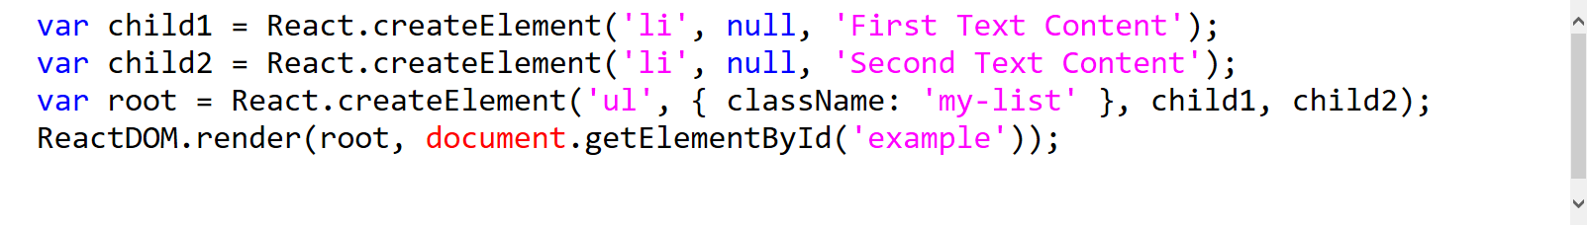
JSX: Totally Optional

Slide 4
JSX Syntax
Really just JavaScript with HTML in the render methods
Use className instead of class
Elements are synthetic
And events are synthetic
Actually, everything is totally fake
But it still magically works

Slide 5
Binding to Data

Slide 6
Bindings
Mustache syntax {}
Bind to props
Don’t overthink it, this is totally easy!

Slide 7
Creating Components

Slide 8
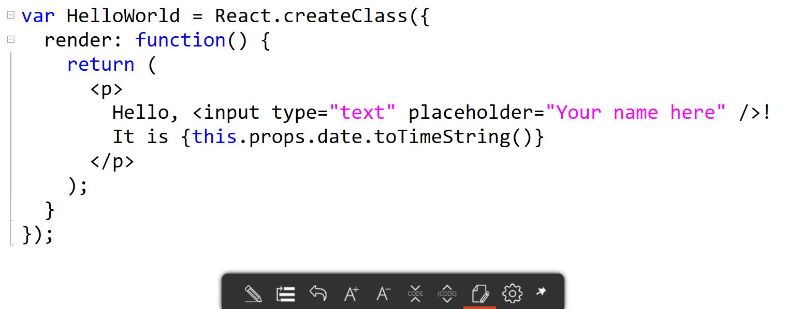
Creating Components

Slide 9
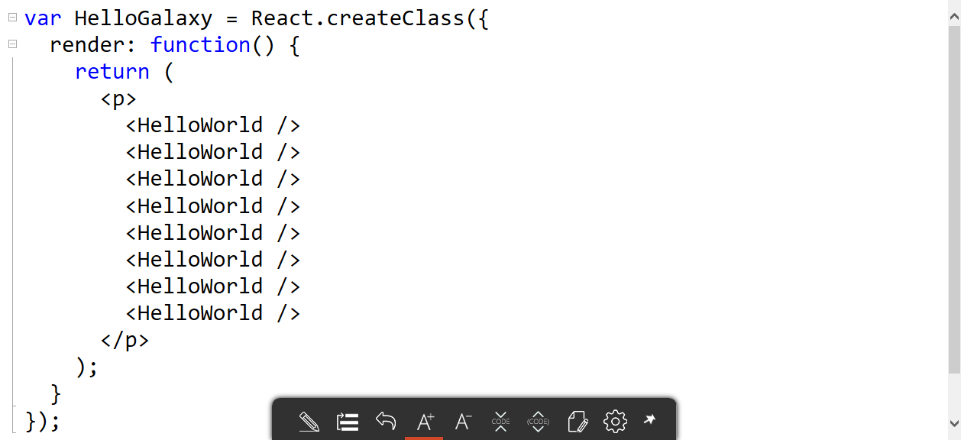
Creating Components
var HelloWorld = React.createClass({ render: function() { return ( <p> Hello, <input type="text" placeholder="Your name here" />! It is {this.props.date.toTimeString()} </p> ); } });

Slide 10
Precompiled JSX Captain Isomorphic!

Slide 11
JSX
Notes:
Clone https://github.com/reactjs/React.NET and run

